Slide 1
SUBWAY SYSTEM SIMULATOR
Team – A : Elite
Client: Dr. Michael Oudshoorn
Team Members:-
Prudvi Krishna Tarugu Subbaiah
Mahesh Babu Kadiyala
Balaji Vinay Banala
Grevil Gonsalo Lopes
Kranthi Kumar Mukka
Ghori Mohammad
Revathi Chittapureddy

Slide 2
Contents
Introduction
Requirements
Dispatcher Prototype
Strategy
Issues Faced
In progress
Test Plan

Slide 3
Introduction
Developing subway system simulator with automated train system.
User sits at the dispatcher and overlooks the working of system.
Dispatcher can start or stop the system.
Notes:
safety

Slide 4
Requirements
Automated train system should be developed by considering safety as main criteria
If user clicks on emergency button then entire train system should be stopped and If the user presses start button followed by emergency stop then the system will be restarted rather than resuming.
If fault layer misses a message, then source system need to generate another request (up to 3 times) to the destination system.
The trains and tracks communicate directly and dispatcher doesn’t do anything except enabling trains and tracks.

Slide 5
Requirements (Cont.)
To start the simulator user need to provide only single input action by clicking START button located in the dispatcher
Other than user doesn’t do anything. He simply monitors the movement of the trains.
Trains should not collide with each other, to meet this requirement we need to provide locks to the section so that only one train can have a section at a time

Slide 6
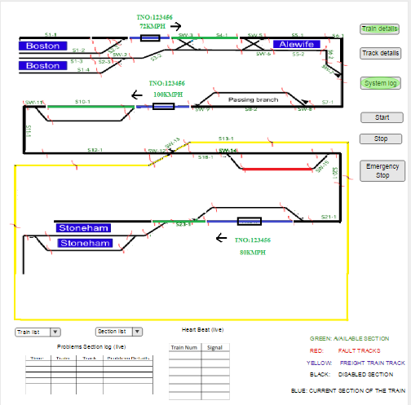
Dispatcher Prototype

Slide 7
Strategy we followed:
Firstly, we are planning to design a simulation with single train and track.
After that we will work on Graphical User Interface.
Then we will move on to the development of the entire system that consists of 4 trains and 1 freight train.
Finally we will test our system using fault injection.

Slide 8
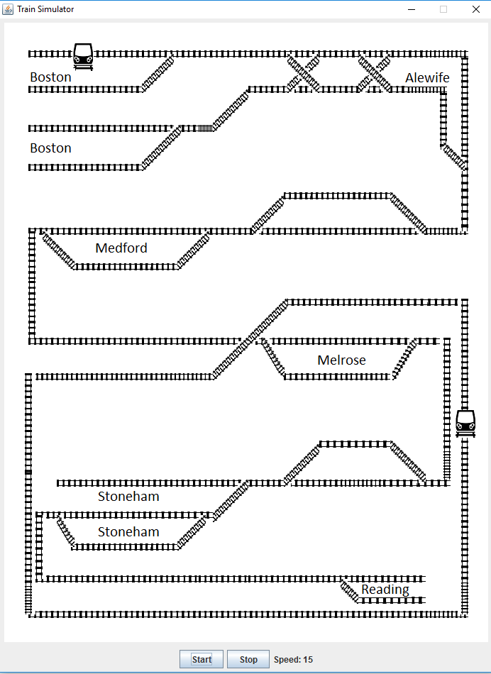
Initial development

Slide 9
Comments
Updating the speed of each individual in live while its moving.
Solution: We have included a column in the table to update the speed of the train in live.
Reduce the speed of the freight train and to differentiate it.

Slide 10
Issues faced:
Merge conflicts while integrating with git
Hitting database by multiple threads at a time, this is causing changing in behavior of trains

Slide 11
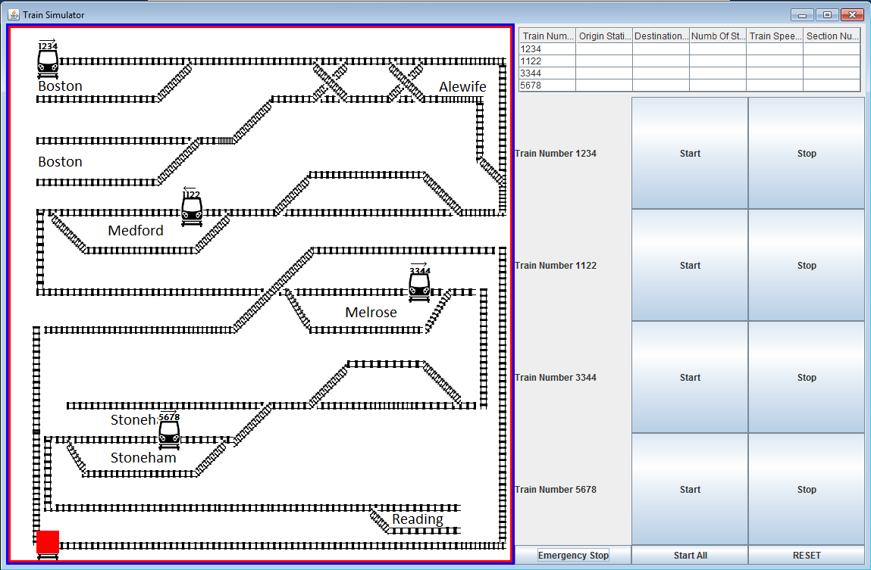
Final Development

Slide 12
In progress
Implementing locks on sections so that one section can be occupied by one train at a given time
Other trains will wait until current train unlocks the section
Because of this we can avoid collision between trains
Testing:
Unit testing need to be done to know the behavior of the trains and tracks
Integration testing also need to be done, to know whether the collision between trains happening or not

Slide 13
Test plan
we will going to test the functionality of buttons, whether they are working properly or not, if the behavior of the buttons is good, we will move with next test
First we will test behavior of train and track modules, whether they are meeting the safety requirements
If we wound no collision happens among passenger trains and also with freight train, then we will move on to the next test
We will test the right panel in dispatcher with the values such as train speed, section max speed are updating in the right panel

Slide 14
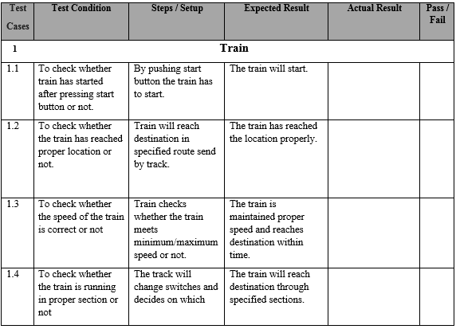
Test cases

Slide 15
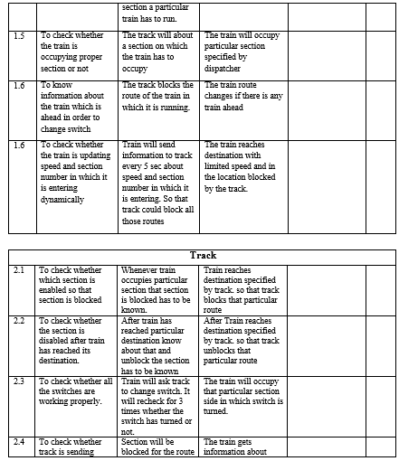
Test cases(Contd..)

Slide 16
Demo

Slide 17
Thank You

